Slide 1




GROUP 8 PROJECT PRESENTATION
Group Members:
BUBUTOR CORBAN ENAM
PATIENCE ASUN AKOSUA
APETORGBOR ISRAEL
KASSIM BALLU BADUONG
OUTLINE:
A brief introduction about the data set
Tools and libraries
Questions
Visualizations and insights
Machine Learning
Conclusions
Recommendations
DATASET: BANK PERSONAL LOAN MODELLING (DigiCap Capstone Project).csv
SOURCE: Kaggle.com

Slide 2



A brief Information about the Dataset
Thera Bank aims to expand its customer base, primarily liability customers, to increase loan business and earn more interest on loans. The bank's retail marketing department aims to target customers with a higher probability of purchasing loans, reducing campaign costs and increasing the success ratio. A successful campaign for liability customers demonstrated a healthy conversion rate of over 9%.
There are fourteen columns and five thousand rows in the dataset:
Columns includes: ID, Age, Experience, Income, Family, CCAvg, Education, Mortgage, Personal loan, Security Account, CD Account,Online, CreditCard

Slide 3
Column descriptions:
Column descriptions ID Customer ID Age Customer's age in completed years’ Experience #years of professional experience Income Annual income of the customer (000)𝑍𝐼𝑃𝐶𝑜𝑑𝑒𝐻𝑜𝑚𝑒𝐴𝑑𝑑𝑟𝑒𝑠𝑠𝑍𝐼𝑃𝑐𝑜𝑑𝑒.𝐹𝑎𝑚𝑖𝑙𝑦𝑠𝑖𝑧𝑒𝑜𝑓𝑡ℎ𝑒𝑐𝑢𝑠𝑡𝑜𝑚𝑒𝑟𝐶𝐶𝐴𝑣𝑔𝐴𝑣𝑔.𝑠𝑝𝑒𝑛𝑑𝑖𝑛𝑔𝑜𝑛𝑐𝑟𝑒𝑑𝑖𝑡𝑐𝑎𝑟𝑑𝑠𝑝𝑒𝑟𝑚𝑜𝑛𝑡ℎ(000)�������������������������.�������������ℎ�����������������.����������������������������ℎ(000) Education Level. 1: Undergrad; 2: Graduate; 3: Advanced/Professional Mortgage Value of house mortgage if any. ($000) Personal Loan Did this customer accept the personal loan offered in the last campaign? Securities Account Does the customer have a securities account with the bank? CD Account Does the customer have a certificate of deposit (CD) account with the bank? Online Does the customer use internet banking facilities? Credit Card Does the customer uses a credit card issued by Universal Bank?
ID: Customer ID, Age: Customer's age in completed years Experience: years of professional experience, Income: Annual income of the customer ($000) ZIPCode: Home Address ZIP code. Family; Family size of the customer CCAvg; Average spending on credit cards per month ($000) Education; Education Level. 1: Undergrad; 2: Graduate; 3: Advanced/Professional Mortgage Value of house mortgage if any. ($000)

Slide 4
Personal Loan, Did this customer accept the personal loan offered in the last campaign? Securities Account, Does the customer have a securities account with the bank? CD Account, Does the customer have a certificate of deposit (CD) account with the bank? Online, Does the customer use internet banking facilities? Credit Card, Does the customer use a credit card issued by Universal Bank?
Column for Dichotomous response:

Slide 5
Tools and Libraries:
Python: Jupyter Notebook
Pandas
Numpy
Matplot
Seaborn
Metrics
Scikit-learn
Ipython
Graghviz
SciPy
Cufflinks
Counter

Slide 6
Questions
What insight can be derived from the data?
Which education constitute greater portion of the customers?
How is the customers income distributed? ( thus, what portion of customers are above the average income).
What is the age distribution of the customers?
How are the variables correlating?

Slide 7
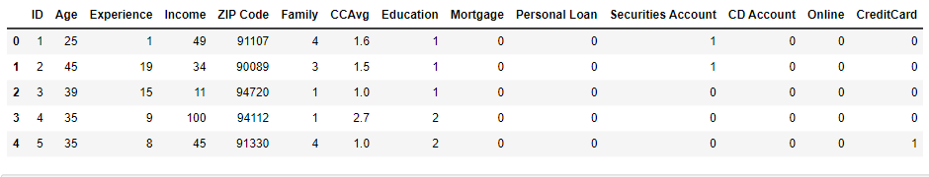
Detail from the data
View the first five rows of the dataset

Slide 8
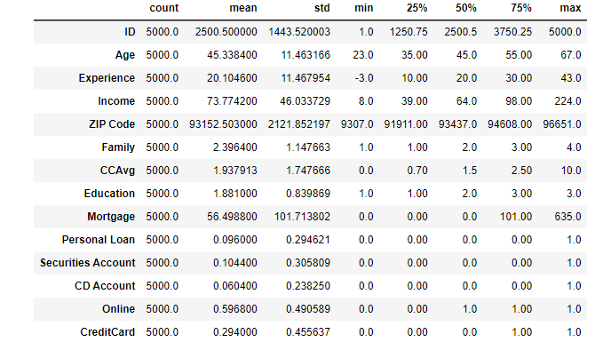
Description of the dataset

Slide 9
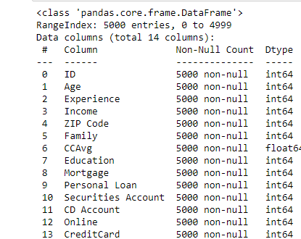
Information Derived from the data

Slide 10
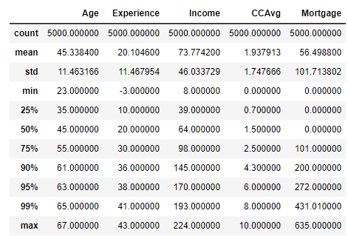
Checking for outlier

Slide 11

Exploratory Data Analysis

Slide 12
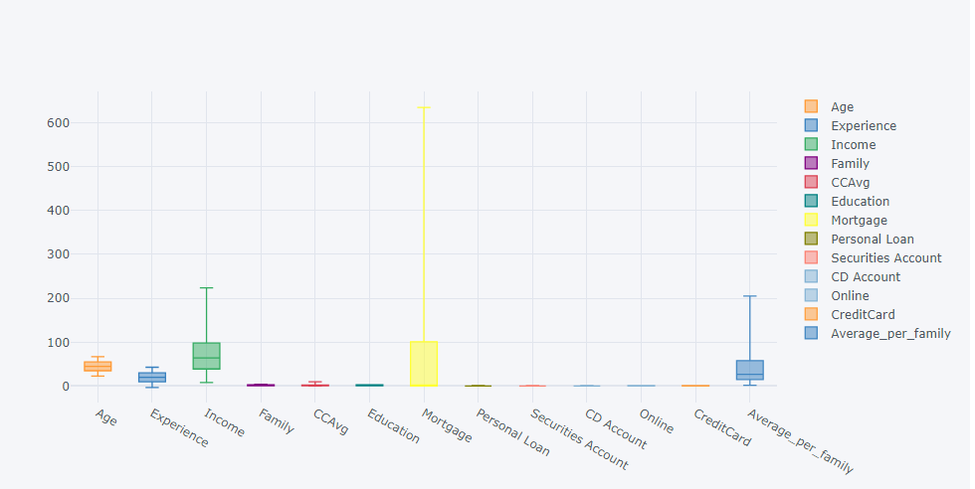
Boxplots of almost all the features which shows absence of outlier

Slide 13
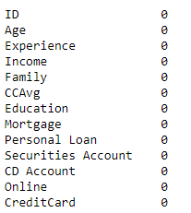
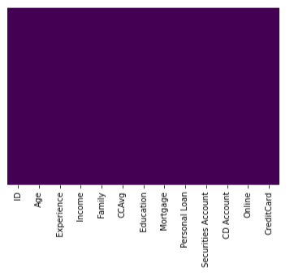
From the above there is no missing values

Slide 14
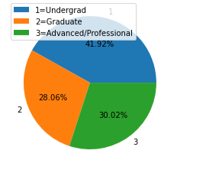
The above shows that most of the banks customers are Undergraduates recording to about 41.92% followed by the advanced/ Professional amount to about 30.02% and the graduates, the least of about 28.06%

Slide 15
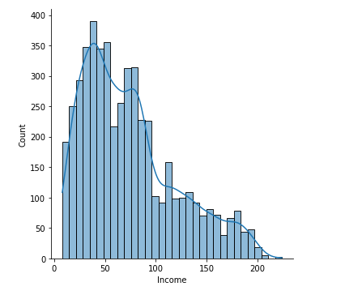

Most of the customers earn below the average salary

Slide 16
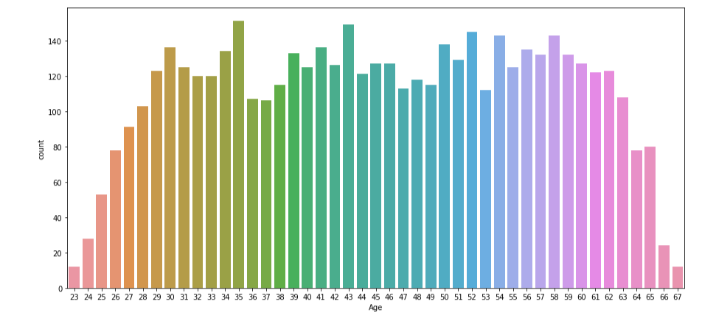
Countplot of the age distribution of customers

Slide 17
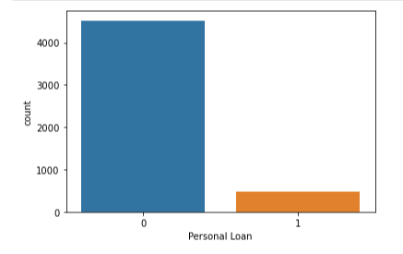
Plot of personal loan
Most of the customer did not purchase the loan even after the campaign

Slide 18
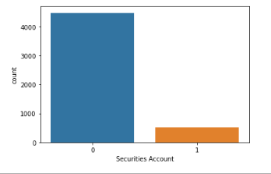
Most of the customer do not have Securities account

Slide 19
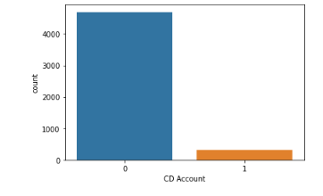
Most of the customer do not have CD account

Slide 20
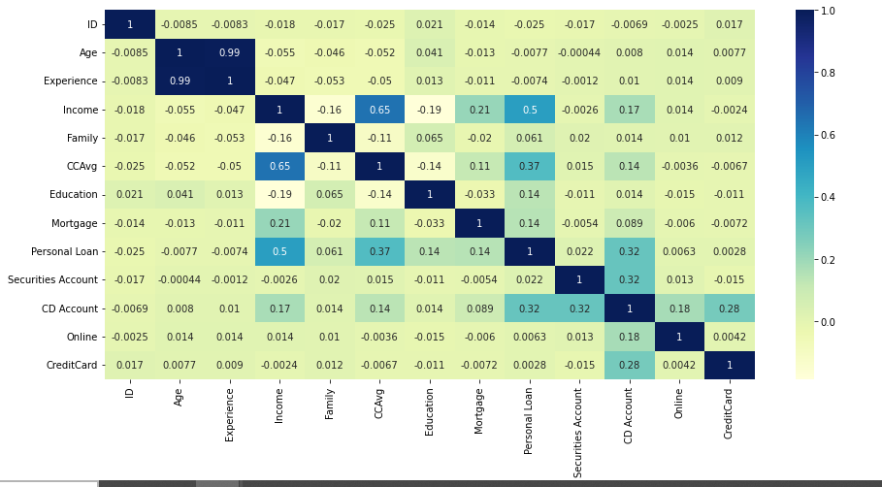
Heatmap of the correlation among the variables in the dataset

Slide 21
To address the problem of Multicollinearity, we identify predetermined data with high correlation (assume high correlation limit is 0.70000) and drop one(Age).
Add addition column

Slide 22
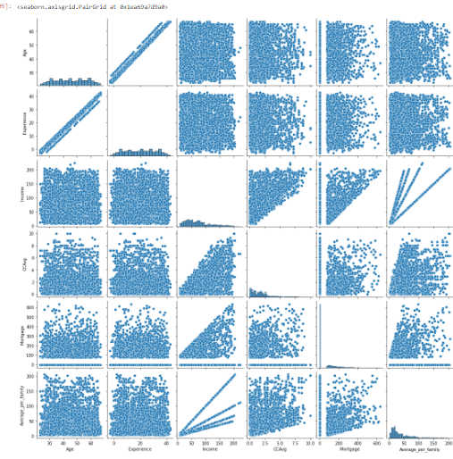
pair plot of how each data relate with each other

Slide 23
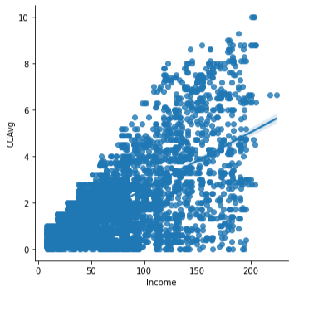
the scatter plot above shows that the more your income ,the more your Avg. spending on credit cards per month. Thus , there exist a positive relationship between Customer Income and their spending on credit cards.

Slide 24
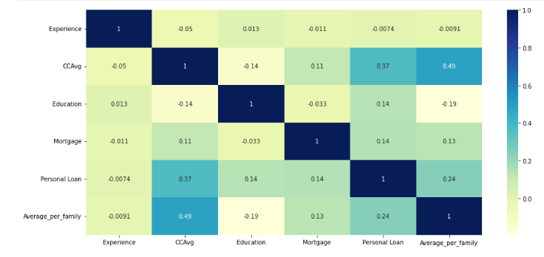
No correlation above 0.70 hence void of multicollinearity

Slide 25

MACHINE LEARNING

Slide 26
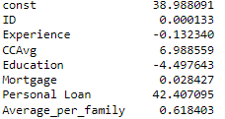
LINEAR REGRESSION
Parameters

Slide 27

Summary of the OLS linear regression

Slide 28
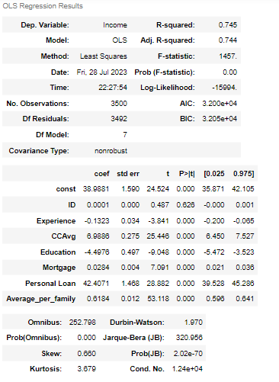

Slide 29
An indicator of how well a statistical model fits the data is the log-likelihood. It is, specifically, the natural logarithm of the likelihood function, which, given the model's parameters, is the probability of witnessing the supplied data.
Since the likelihood function assessed at its maximum is likely to be a high number (since the logarithm of a number between 0 and 1 is negative), a log-likelihood of -15994 in your example indicates that the model fits the data reasonably well.

Slide 30
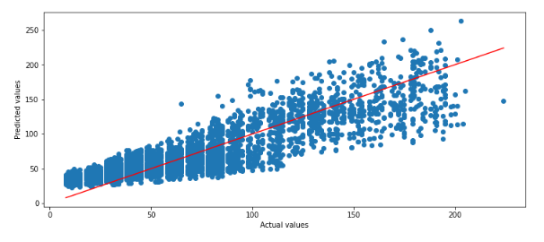
Regression plot of the predicted variable against the actual

Slide 31
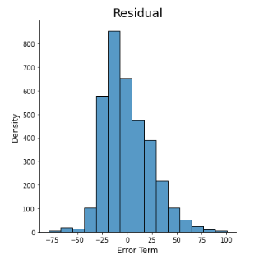
Residual plot

Slide 32

Random Forest

Slide 33
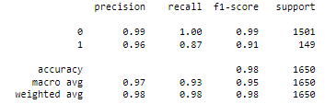
Accuracy
Classification report
Accuracy

Slide 34
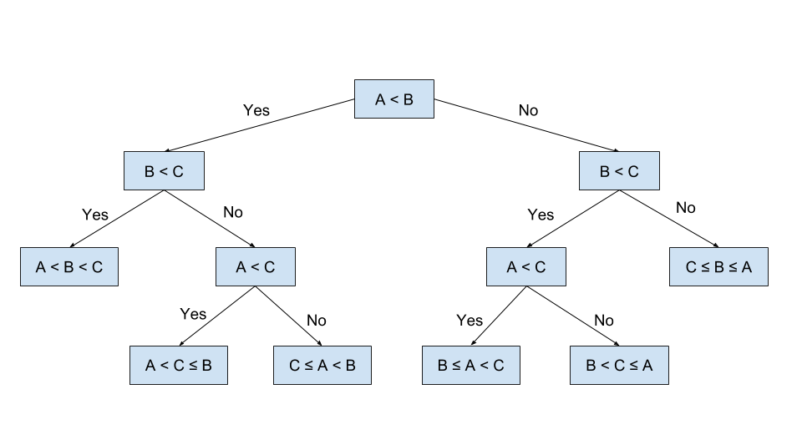
Decision Tree

Slide 35
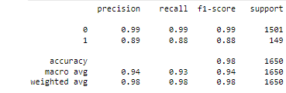

Slide 36
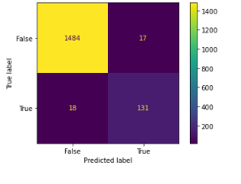
Confusion Matrix

Slide 37
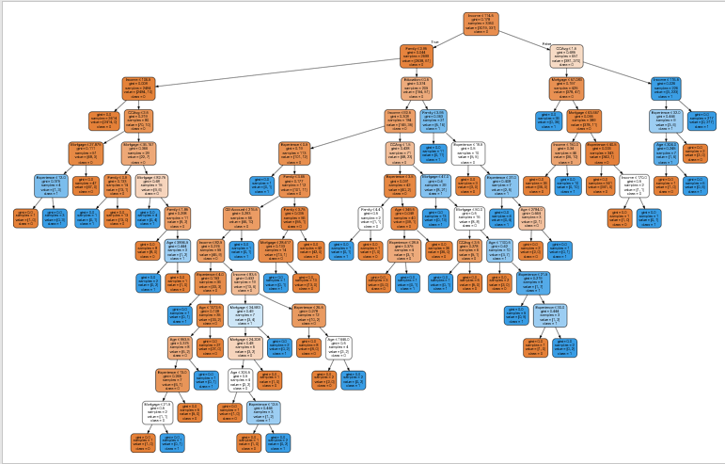
Decision tree obtained from the dataset

Slide 38
Conclusion
Most of the customers earn below the average income
The regressors of the regressed in the OLS estimation explained about 75% of the model.
Most of the regressors are statistically significant.
the selected model (random forest) has the highest accuracy of about 98%
The campign initiated by Thera Bank did not yield a high desirable result since little or no attention had been given to the key drive of the personal loan. Thus, CD Account, CC Avg and the income of the customers.

Slide 39
Recommendation
The undergraduates constituted great percent of the customer hence the next campaign should factor their interest. ( student loan can be an initiative.
Most of the customers earn below the average of $74 therefore decrease interest rate but to a profitable level would induce customers purchase of the loan.
Securing Credit Card Account is seen to play a key role in purchase of Personal loan so, if this is provided at a discounted rate, purchase of the loan would increase

